Slide 1
Student Management System

Slide 2
Teams Members
Ibrahim Ali Kaldesh BN:1
Ahmed Gamal Saeed BN:3
Ahmed Hamdy Mohammed BN:4
Aya Osama BN:13
Bassant Amr BN:14

Slide 3
User of System
Role of User
▸Admin
▸Access Data of student
▸Access Data of subject
▸Access Data of teacher (CURD)

Slide 4
Project Overview
Student Management system that allows for creating reading updating and deleting students information crude create read update delete. This is the application we are going to build on the home page we have a list of students presented in a table for each student we have available three action buttons that allow us to view edit and delete students from a database. If we press the first button with the information icon you can view the information of a selected student we use here a bootstrap model to present the data to the user. If we press the second button with the edit icon we can edit the information of a selected student. If we press the third button with the delete icon we can delete a selected student from a database.

Slide 5
Project Overview (cont.)
Before deleting a student we are first presented with a bootstrap model that asks us to confirm the deletion.
we can also add a new student when adding a new student we need to provide the student number a first and last name and email a field of study and a gpa.
We also have subjects for each students actually six subjects assigned for each academic year and each subject has an instructor .
we can also add new subjects and instructors for these subject.

Slide 6
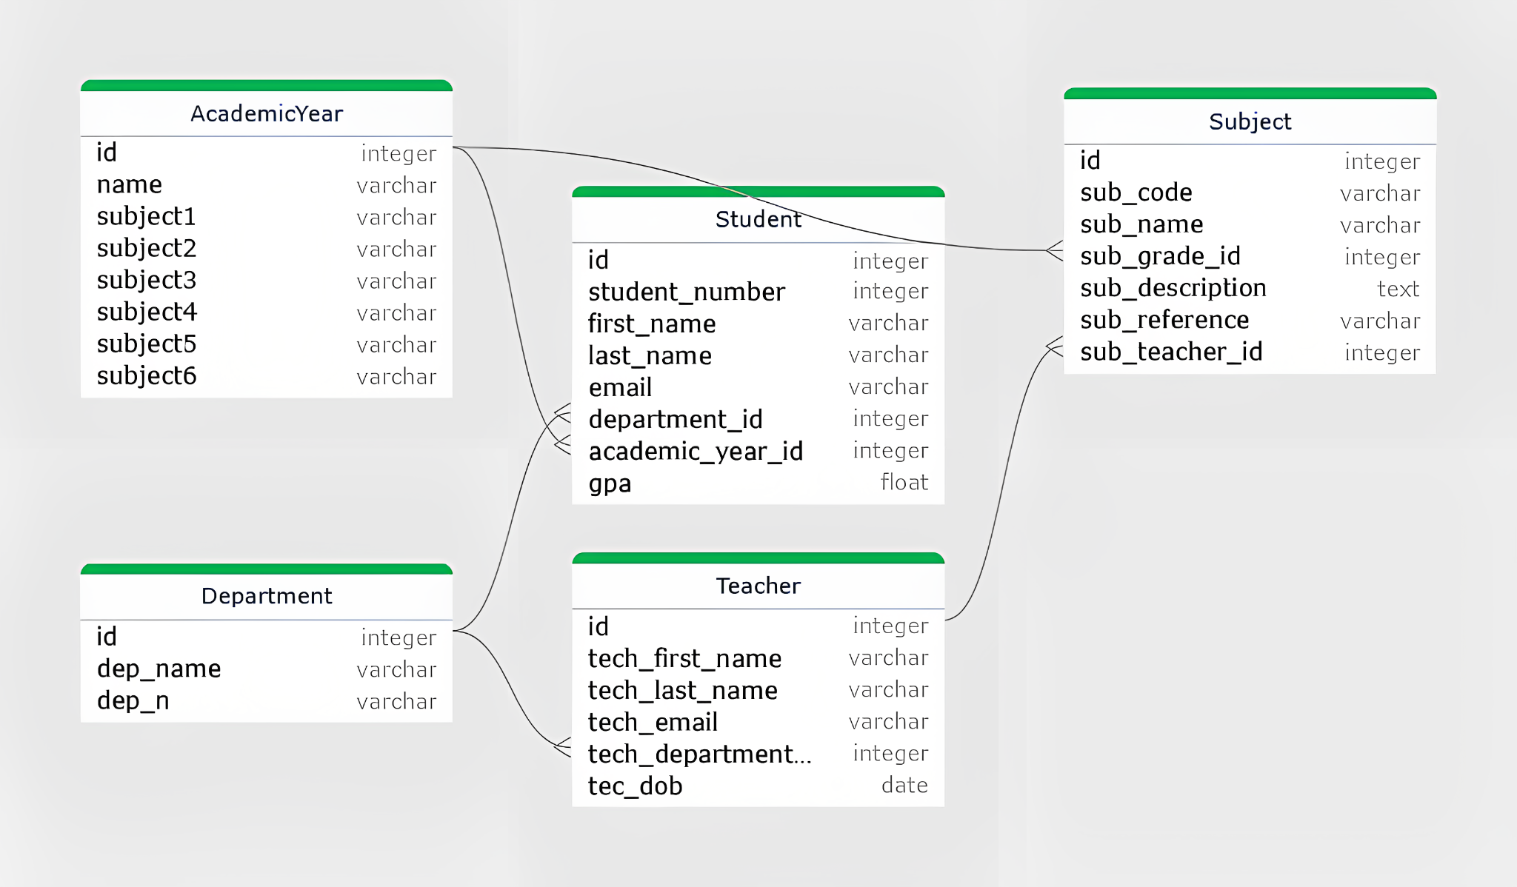
ERD

Slide 7
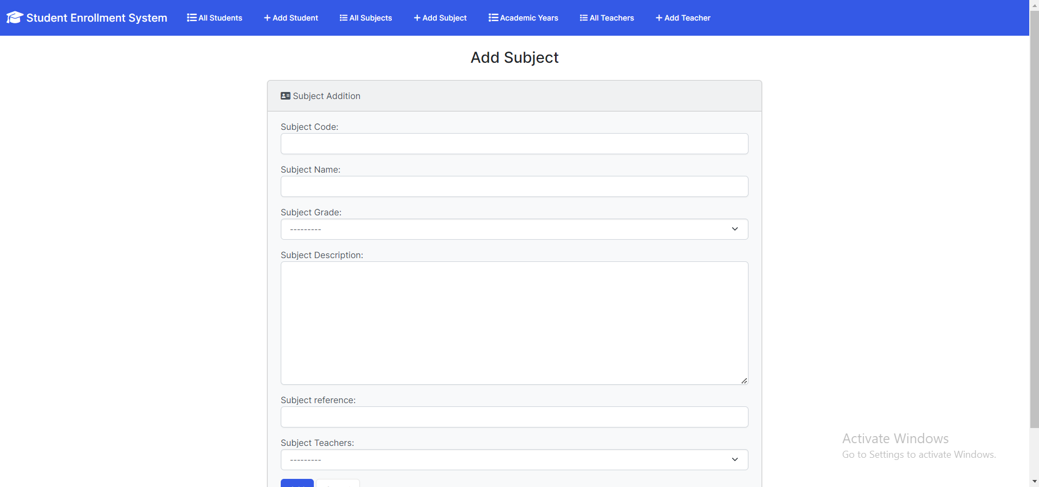
ADD subject

Slide 8
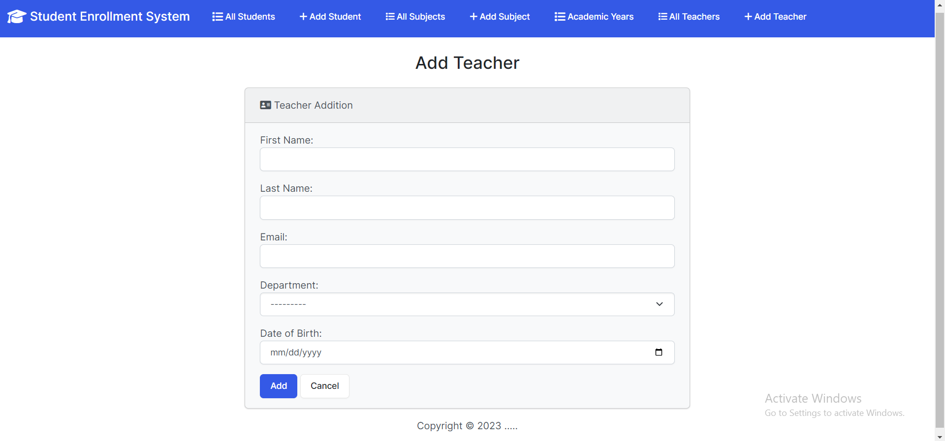
Add Teacher

Slide 9
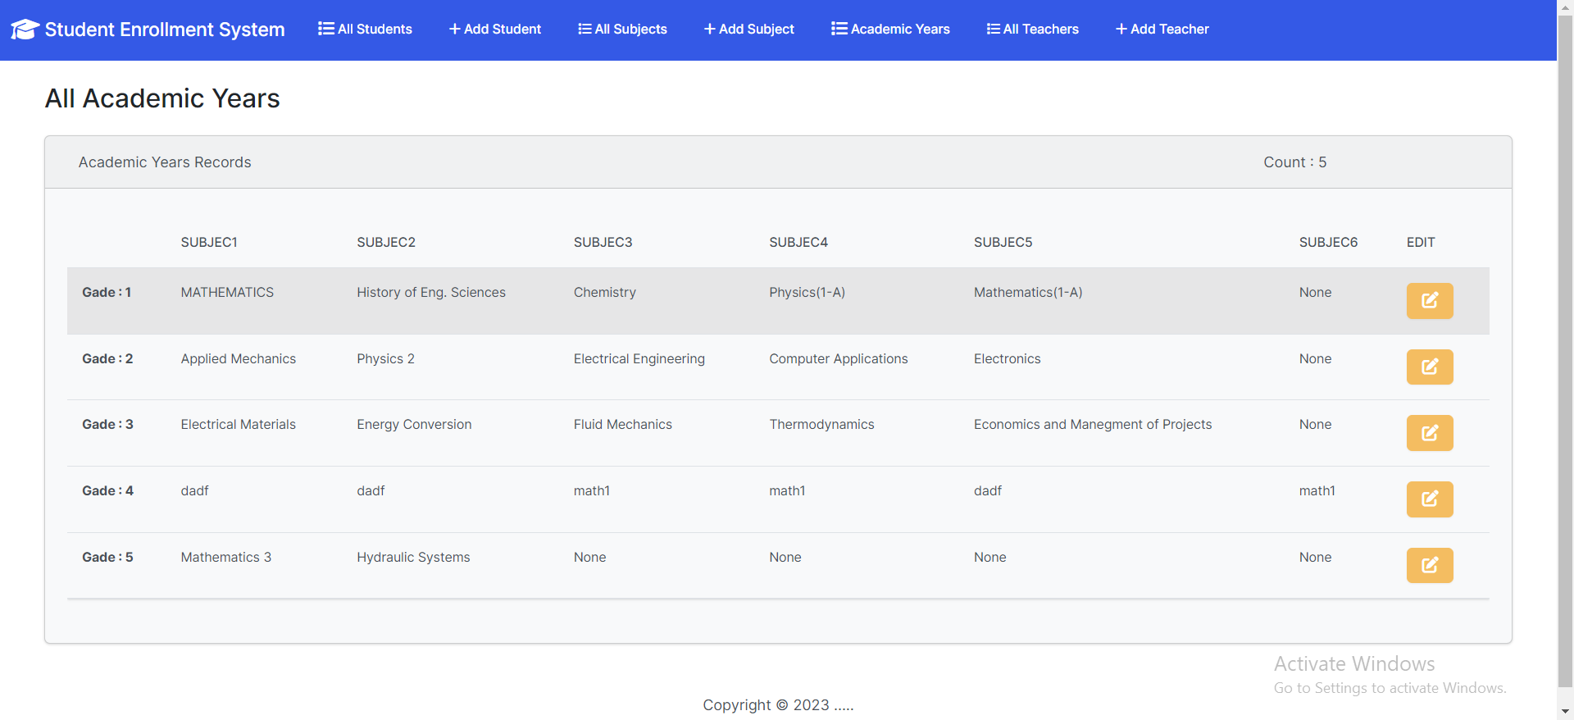
Show Academic years

Slide 10
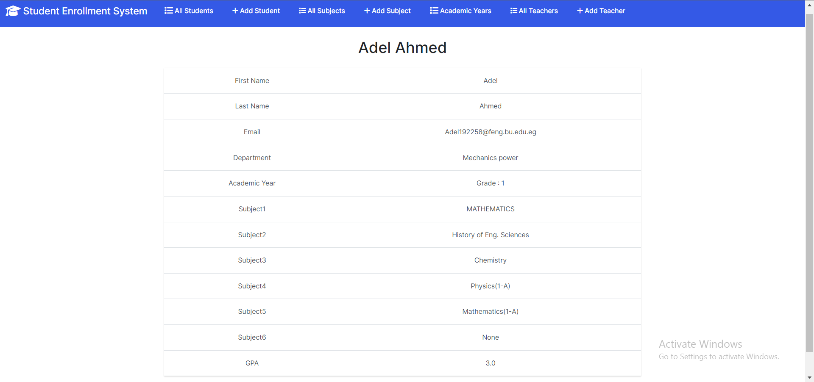
show student record

Slide 11
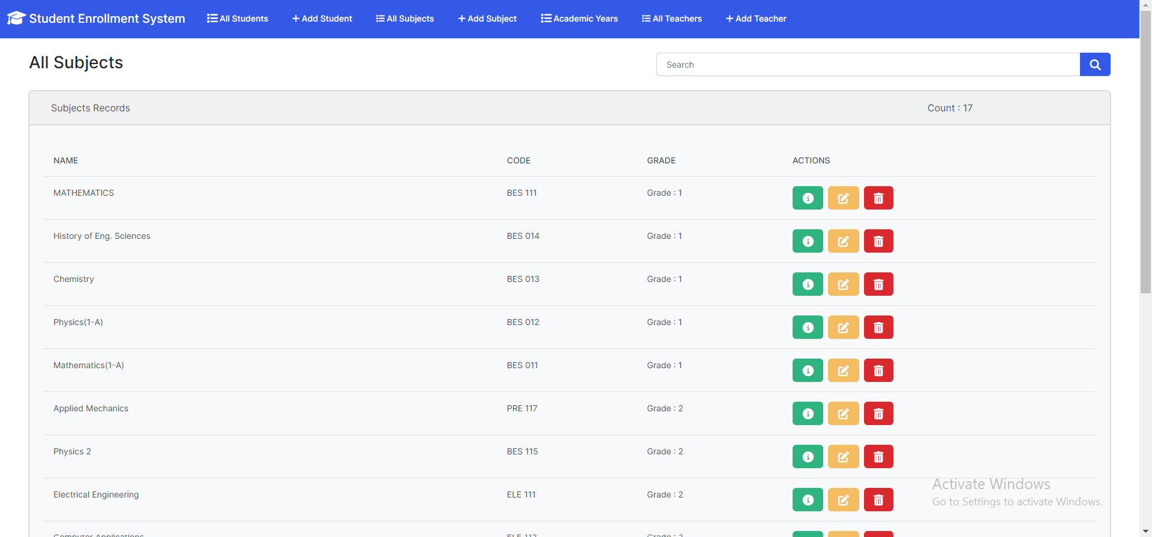
show subjects

Slide 12
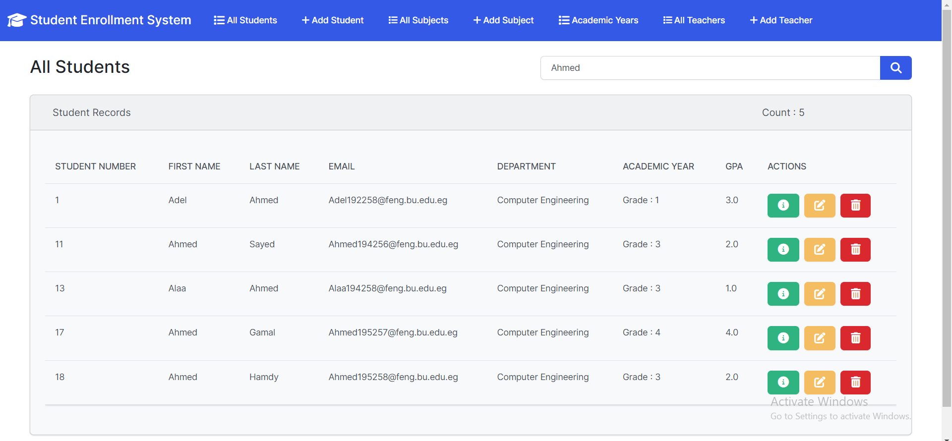
search for record

Slide 13
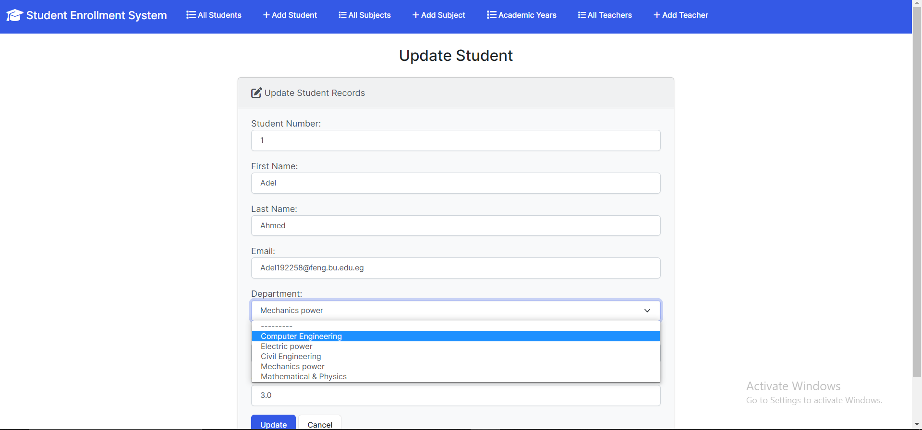
Update Student record

Slide 14
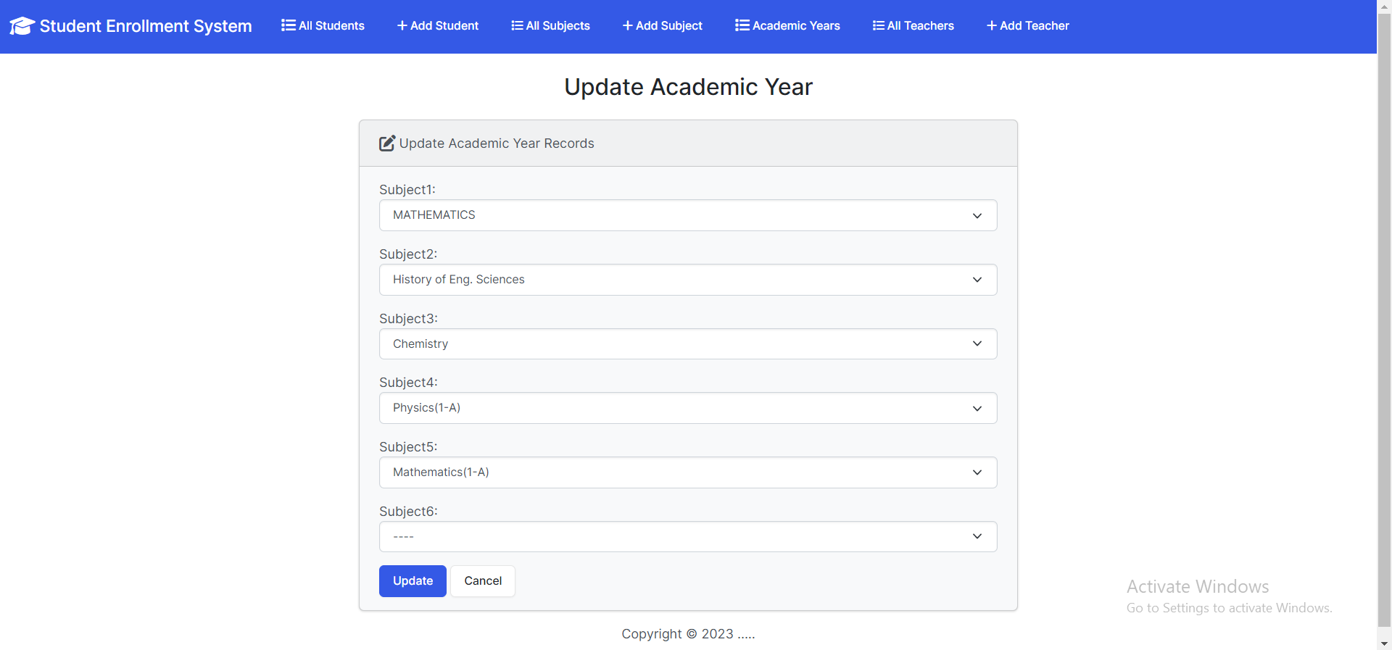
Update Academic year

Slide 15
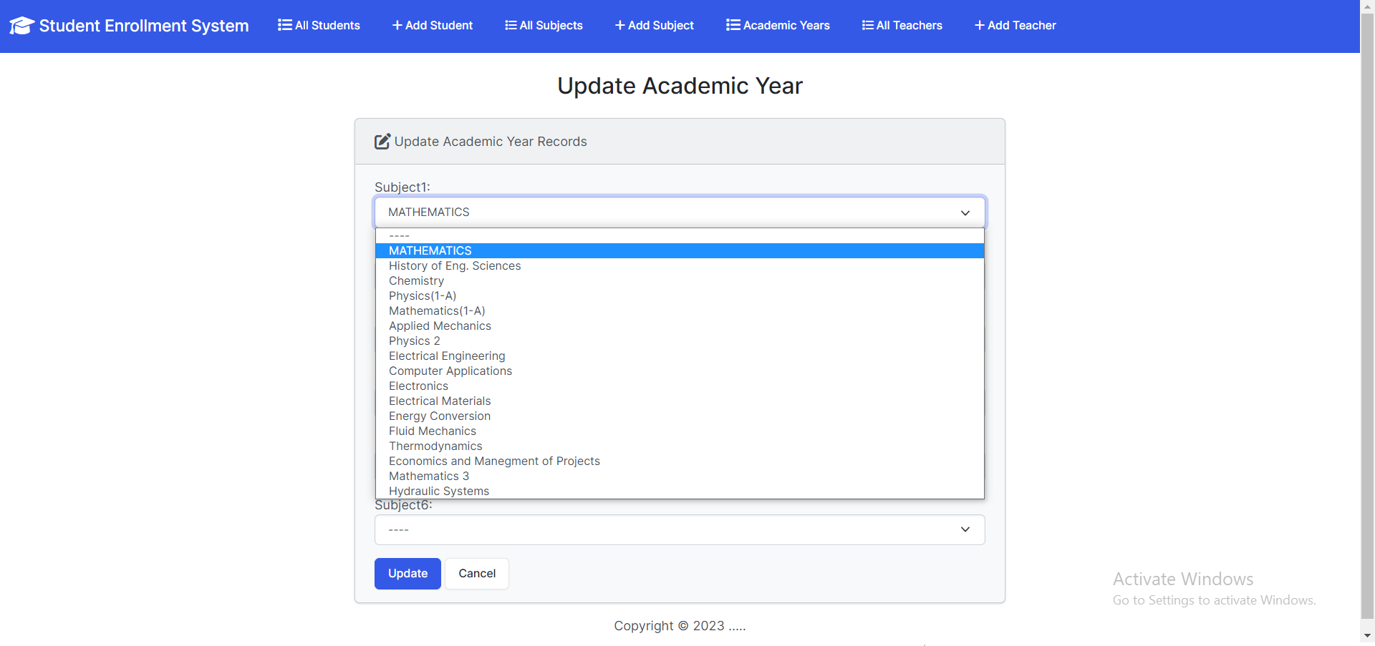

Slide 16
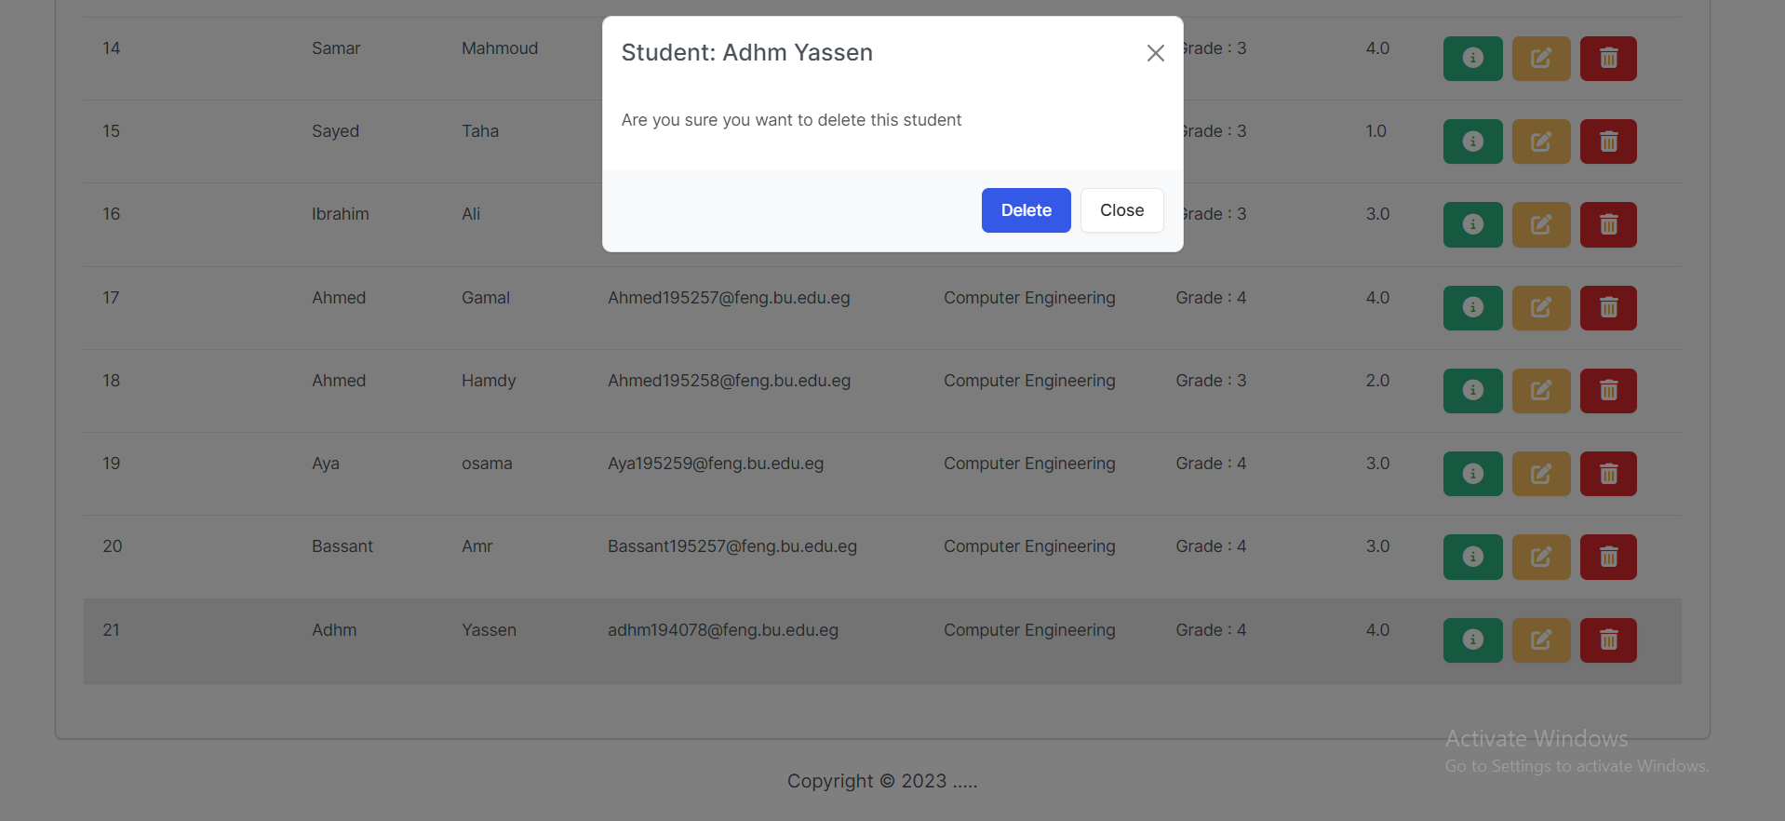
Delete Record

Slide 17
Thank You !

